Slide 1
Complete an Intake Request
Austin Build + Connect (AB+C)
December 9, 2024

Slide 2
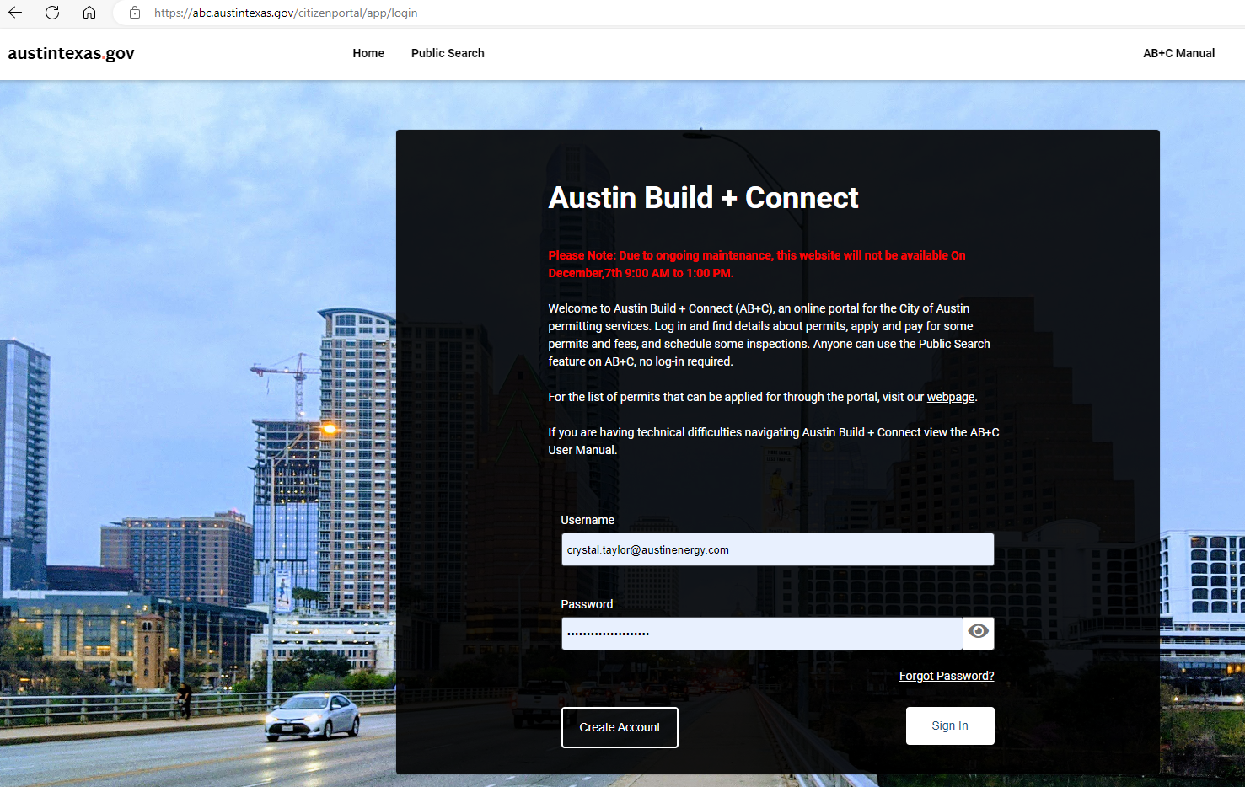
Register a New Account/Login
Use the City of Austin’s, Austin Build + Connect Portal to submit or check on your permits and fees.
You will need to register with the City of Austin online in order submit your Design Intake Request (move to “Apply for Permits/Cases” if you already have a registered account). To register, go to https://abc.austintexas.gov and click on the “Create Account” link.

Slide 3
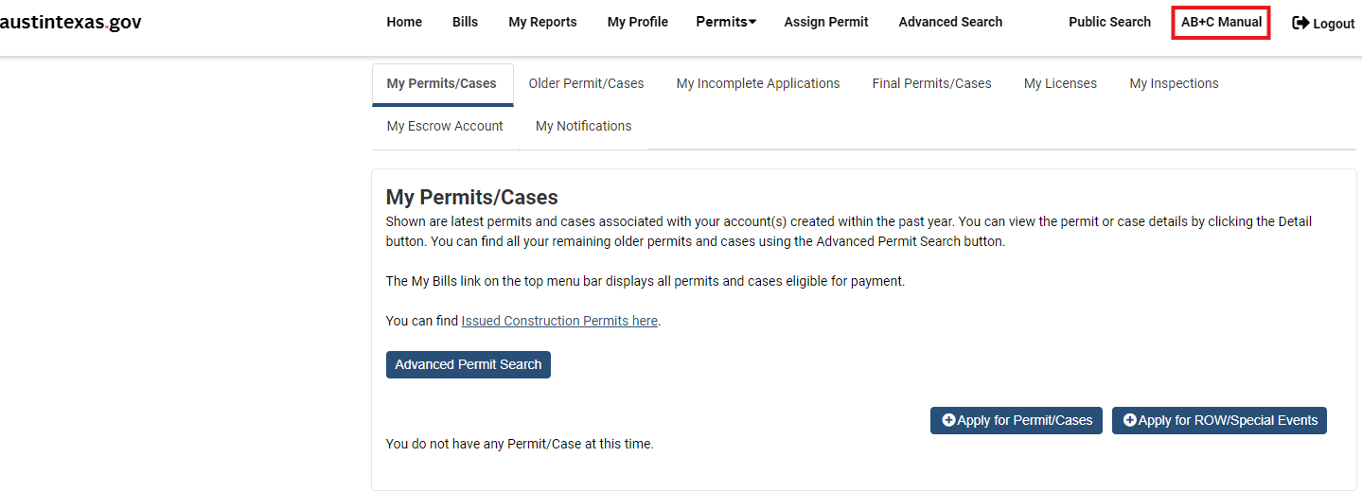
Quick Tip
You may want to familiarize yourself with the City’s online process before starting the Design Intake process . Select the AB+C Manual tab (top right of the screen when you’ve logged in). This will give you all the information you need to address your questions regarding navigating permitting and payment options available on Austin Build + Connect.

Slide 4
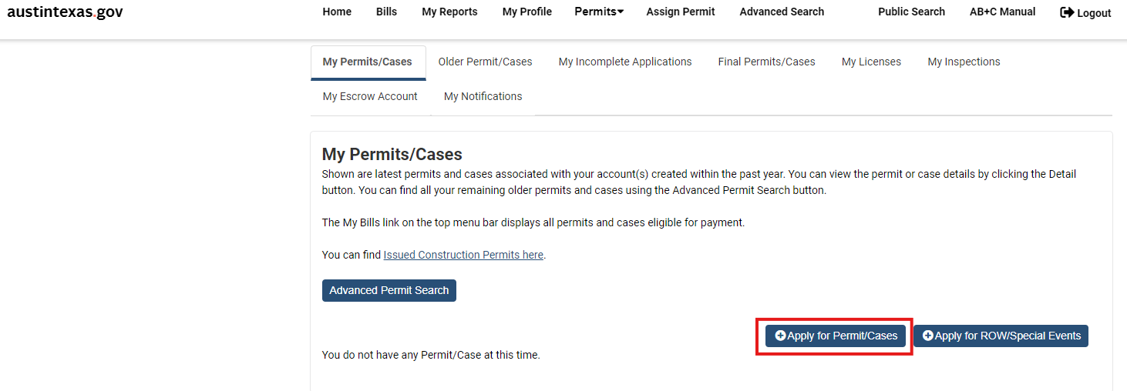
Apply for Permits/Cases
Once registered/logged in you will be taken to the Home Page. Select the blue button “+ Apply for Permits/Cases”
Please note the following steps are NOT for applying for your Electric Permit, this is only used for Design Intake Purposes. For permit information, please visit the Development Services Departments, Understanding the Development Process, page.

Slide 5
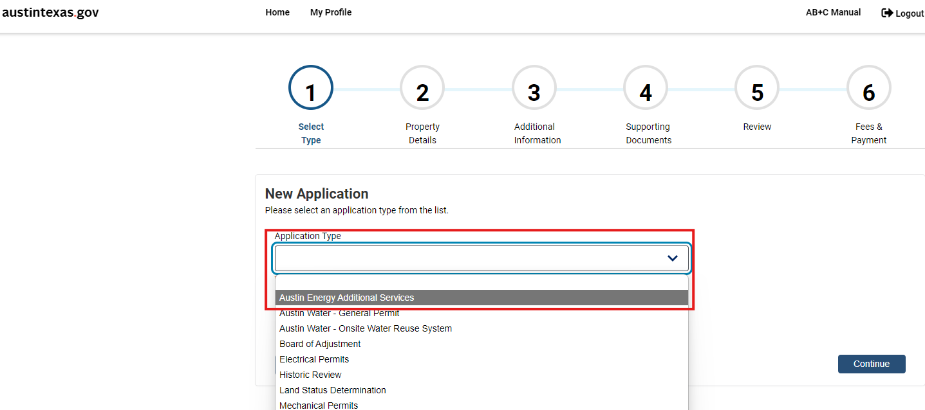
Step 1: New Application – Select Type
From the “Application Type” drop down, select the first option “Austin Energy Additional Services” referred to as AEAS.

Slide 6
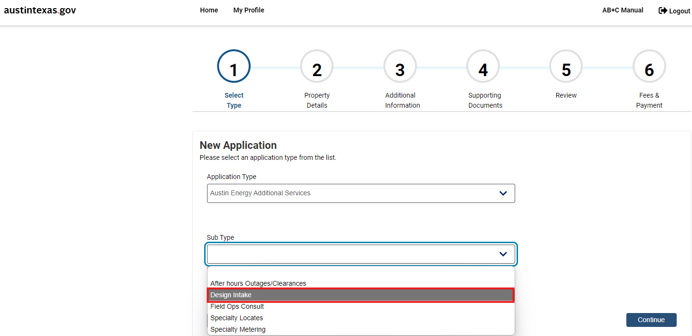
Step 1 (cont.) New Application – Select Type
From the “Sub Type” drop down, select the second option, “Design Intake”

Slide 7
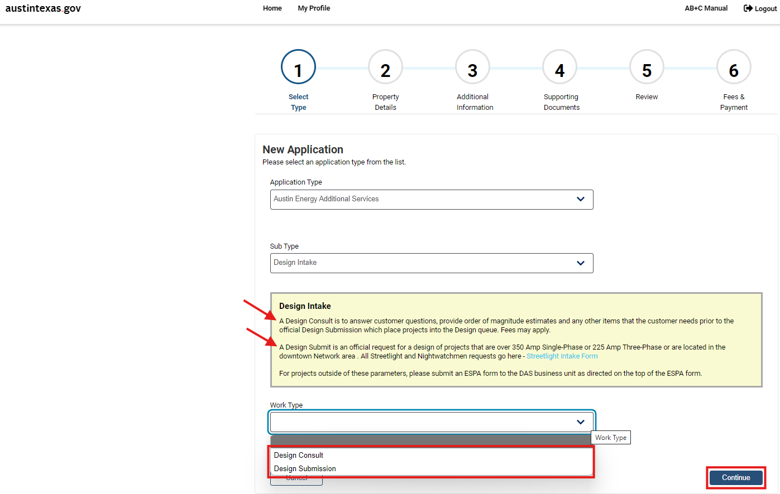
Step 1 (cont.) New Application – Select Type
From the “Work Type” drop down, select either, “Design Consult or Design Submission”.
Click “Continue”

Slide 8
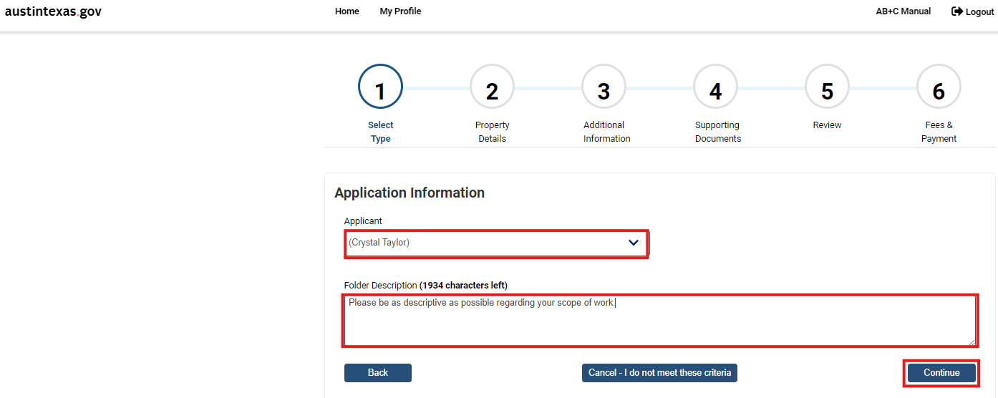
Step 1 (cont.) Application Information
From the “Applicant” drop down, select your name.
In the “Folder Description” field, please be as descriptive as possible regarding your scope of work for the project.
Click “Continue”.

Slide 9
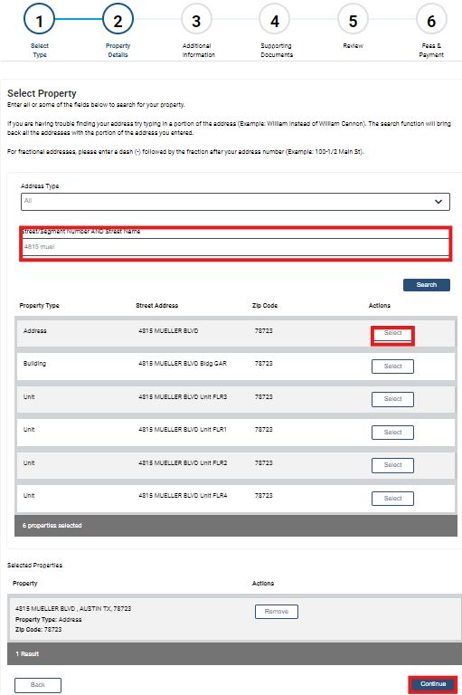
Step 2: Property Details
Type the project address in the “Street/Segment Number AND Street Name” field.
* Try shortening the street name if results are not initially found.
Click “Search”
Find the correct address and click “Select”
Click “Continue”.

Slide 10
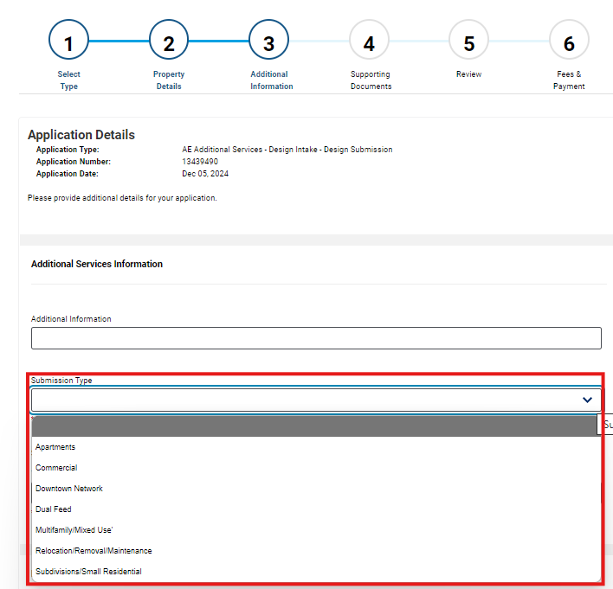
Step 3: Additional Information
From the “Submission Type” drop down, select the best option for your project submission.

Slide 11
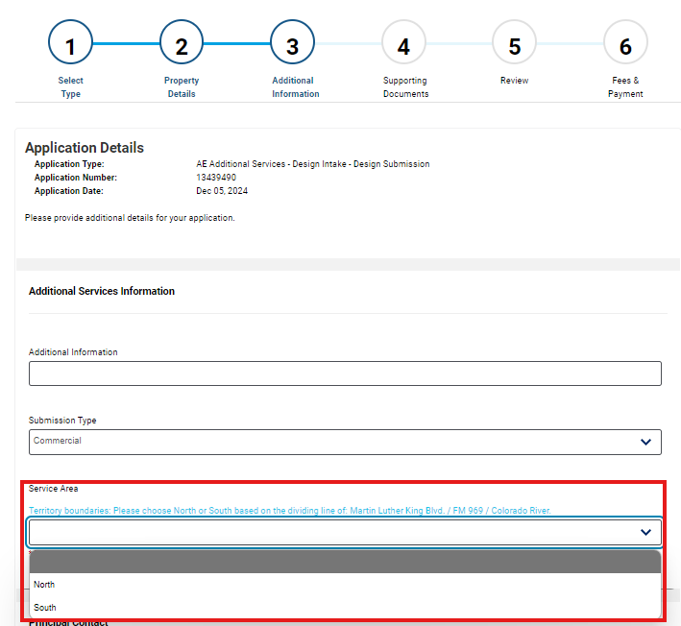
Step 3 (Con’t) Additional Information
From the “Service Area” drop down, select if your project is in North or South Austin.

Slide 12
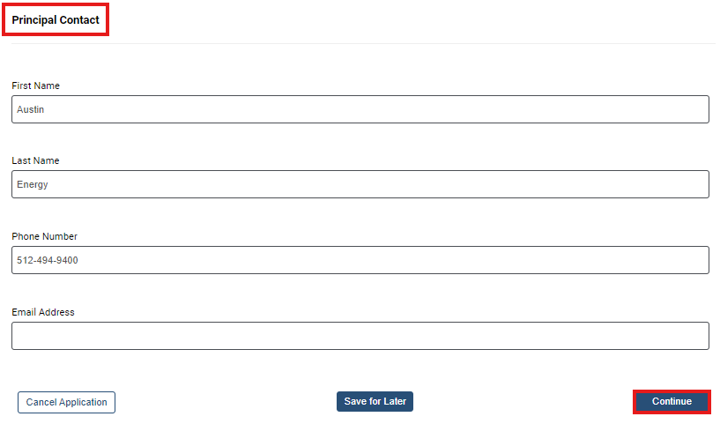
Step 3 (Con’t) Additional Information
AE maintains a single point of contact for projects. Please put this person's name and contact information in the “Principal Contact” fields.
Click “Continue”.

Slide 13
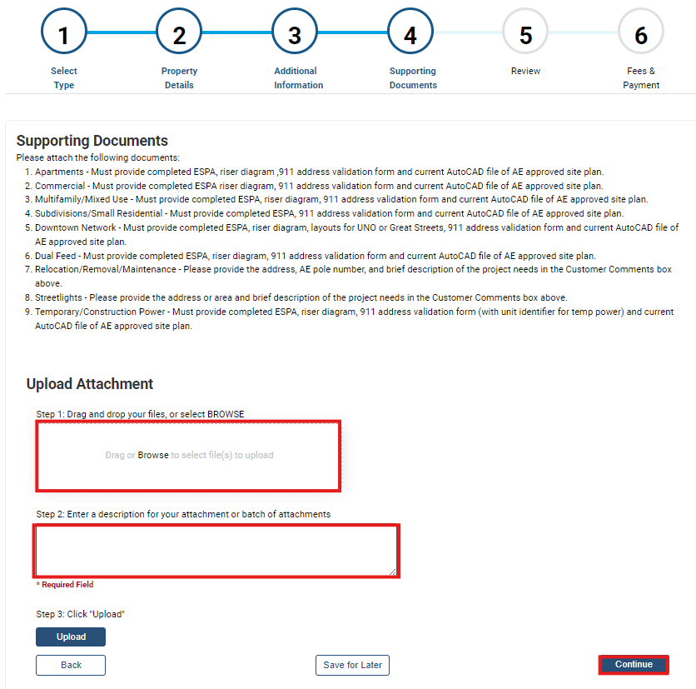
Step 4: Supporting Documents
Please see the list of required documents per project submission type and attach ALL required documents and enter a description for each attachment.
Please submit your ESPA’s in the fillable/editable format.
Click “Continue”.

Slide 14
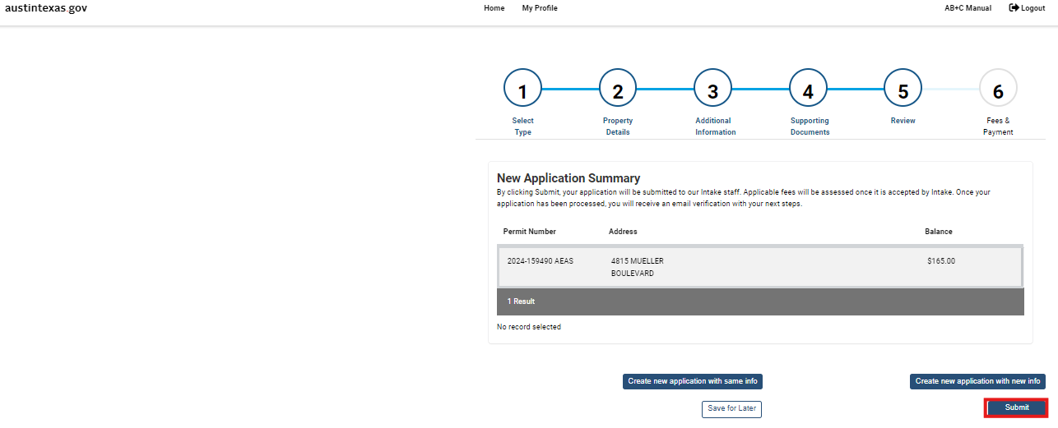
Step 5: New Application Summary - Review
Please make sure to click “Submit” on this page and that you get a confirmation email.
Please note, at this time, there is no fee to submit a Design Intake entry.

Slide 15
Post-Submission Information
An email will be sent to you confirming that your application has been received by Design Intake. As long as you receive this confirmation email, your entry was submitted successfully.
Please note the AEAS “Permit” is only used for Design Intake purposes and will close automatically within 90 days after it’s Released to Design once reviewed by Intake staff. You will receive an email telling you the AEAS “permit” has closed in 90 days. This does NOT affect your Design status or place in queue.
Use the information provided in the AB+C Manual tab if you have any questions or need help.
PLEASE NOTE: This process is NOT applying for your Electric Permit. This is ONLY submitting your project to AE Design.

